Slide 1
Security Architecture and Design
CEH_v10
金凱瑞

Slide 2
Security Architecture and Design
Data Classification
Security Models
State Machine
Biba
Bell-LaPadula
Clark-Wilson Integrity Model
Application Architecture
n-tier Application Design
Service-Oriented Architecture
Cloud-Based Applications
Database Considerations
Security Architecture
Summary

Slide 3
Data Classification
Not all data is created equal. Data classification is an important step when organizing security systems and controls.
Data classification is used to identify and organize information that has similar security control needs.
This allows appropriate access controls to be created.
When you start thinking about security models, it is important to consider your data classifications, because security models are used to help identify who gets to look at what data.
You can’t do this without first classifying and organizing your data resources. Different organizations will use different types of classification schemes, depending on the data resources in place. This is also something you will hear a lot when it comes to the government and perhaps especially the military. Table 14.1 lists common classifications in use within the government.

Slide 4
Classification Description
Top secret
The highest level of data classification. Only a very limited number of people will be able to look at data classified as top secret.
The exposure of secret information would cause serious damage to national security.
Secret
The exposure of confidential information would cause damage to national security.
Confidential

Slide 5
Classification Description
Restricted
Exposure of restricted data would have undesirable effects.
This is information that relates to government business and may not be an indicator of the potential for harm if the information were lost or exposed.
Official
Unclassified information can be viewed by everyone. This may include declassified information that was once considered a higher classification but the threat posed by its exposure has subsided.
Unclassified

Slide 6
Within each of these classification levels there may be additional compartments. Top secret information is not necessarily available to everyone who has been cleared at a top secret level.
Just as not all data is created equal, not all people are created equal. Information sometimes needs to be compartmentalized even beyond these data classification levels.
This is not the only way of categorizing data, of course. Organizations may have different ways of thinking about their information.

Slide 7
Security Models
State Machine
Biba
Bell-LaPadula
Clark-Wilson Integrity Model

Slide 8
Security Models
Security models are used to help enforce access controls.
A security model defines who can perform what action on data. It is an extension of the data classification levels that an organization has identified.
For example, you wouldn’t want to store public data mixed with sensitive data. People who should have access to public data generally shouldn’t have access to sensitive information.
This is not a property that goes in both directions, of course. Someone who has access to top secret data should have access to public data but definitely not the other way around.
These are the sorts of relationships that are defined in the models presented in the following sections.

Slide 9
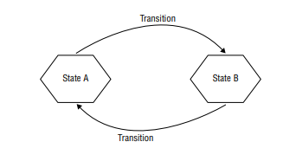
State Machine
Security models are used to help enforce access controls.
A security model defines who can perform what action on data. It is an extension of the data classification levels that an organization has identified.
For example, you wouldn’t want to store public data mixed with sensitive data. People who should have access to public data generally shouldn’t have access to sensitive information.
This is not a property that goes in both directions, of course. Someone who has access to top secret data should have access to public data but definitely not the other way around.
These are the sorts of relationships that are defined in the models presented in the following sections.

Slide 10
A state machine model is used to identify when the overall security of a system has moved to a state that isn’t secure.
This requires that all possible states of the system have been identified. This should include the actions that would be possible to move a system into a particular state and all the possible state transitions.
When a system makes a transition that is unexpected or an action results in an unexpected state, this can be monitored and alerted.
This model is far more abstract than the others discussed here since it doesn’t actually define any expected behaviors. It’s simply a way to model an environment, requiring that someone define expected behaviors and states.

Slide 11
Biba
The Biba Model is named after the man who developed it in 1975, Kenneth Biba.
The goal of the Biba Model is data integrity. Because of this, this model may be referred to as theBiba Integrity Model.
Keep in mind that security is not always about protecting the confidentiality of the data. The integrity of data is just as important. Data that has been altered unexpectedly or by the wrong people can also be damaging to an organization. This may be more complex than you would think. There are three objectives when it comes to ensuring data integrity:

Slide 12
■ Unauthorized parties cannot modify data.
■ Authorized parties cannot modify data without specific authorization.
■ Data should be true and accurate, meaning it has both internal and external consistency.
The second one may appear to be confusing. Just because you have a login to a system or a network does not mean you have access to all data.
The first objective is about ensuring that someone from the outside who doesn’t have access can’t modify data.
The second is about someone from the inside not being able to modify data they shouldn’t be modifying or perhaps shouldn’t even be seeing.
In the Biba Integrity Model, data has classification levels but people also have classification levels. These are also referred to as integrity levels.
A user can only write to an integrity level at or below their own. The inverse of this may make more sense. A user can’t write to an integrity level above their own.
Write is not the only thing you can do to information. You have to factor in read as well. Reading can only be done at or above an integrity level. So, a quick way of thinking about this is read up, write down.

Slide 13
Bell-LaPadula
Bell-LaPadula is used in government or military implementations and the intent is to protect confidentiality.
Bell-LaPadula is focused on confidentiality rather than integrity.
The Bell-LaPadula properties are defined as follows:
■ The Simple Security Property says that a subject at one security level may not read an object at a higher security level.
■ The * (star) Property says that a subject at one security level may not write to an object at a lower security level.
■ The Discretionary Security Property uses an access matrix to indicate discretionary access.
Bell-LaPadula provides for two mandatory access control rules (Simple Security Property and * Property) and a single discretionary access control rule. Mandatory access control is handled by the operating system.
Rules are created based on policy and they can’t be manipulated by users of the system. Discretionary access control allows users to set their own access rules based on their needs and the data they control.
With discretionary access control, the enterprise doesn’t have control over what subjects are allowed to access objects.

Slide 14
Clark-Wilson Integrity Model
The Clark-Wilson model is another one that focuses on integrity rather than confidentiality.
This doesn’t mean, though, that it is the same as the Biba Model, even if the end result is intended to be the same. Unlike Biba, Clark-Wilson does not rely on a state machine. It also doesn’t make use of subjects and objects exclusively. Clark-Wilson adds in programs.
Biba is used to protect information at higher levels of classification, Clark-Wilson is used and is applicable across all levels of data classification.
Rather than defining a state machine, as noted, Clark-Wilson defines data items and only allows access through a small number of known programs.
If any subject other than those allowed attempt to access the object, even through the known program/transaction, it’s a violation.
The same is true for attempting transactions that are not defined by attempting to use other programs. This would also be considered a violation.

Slide 15
Application Architecture
n-tier Application Design
Service-Oriented Architecture
Cloud-Based Applications
Database Considerations

Slide 16
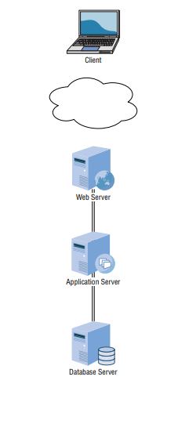
n-tier Application Design
The n-tier design is a tiered application model. In some cases, you may see a version of this referred to as the model-view-controller (MVC) design, even if there may be other elements in those multiple tiers.
These tiers are also referred to as the Presentation, Application, Business, and Data Access layers.
You can see an example of this design in Figure 14.2. The Presentation layer, which is the same as the view, is at the client, where the laptop is in the figure. The next layer is the Application layer.
This is where the logic resides. Programmable functionality lives in the Application layer. This may sometimes be broken up into the Application and Business Logic layers.
14.2

Slide 17
The data layer is the model in the MVC design. It is the way data is organized and connected. Typically, this element is a database. Relational databases are commonly used as the backend for web applications.
A relational database helps with the data model, since this type of database is about defining relationships between the different data objects. This definition, or schema, is a way of providing some visualization to the data model for the application.
The Structured Query Language (SQL) is used to create the database and its component tables as well as add data and retrieve the data. Actions on the database are accomplished through the use of SQL statements, called queries. Relational databases use an entity-relationship model. Entities are things like tables and fields in the tables.

Slide 18
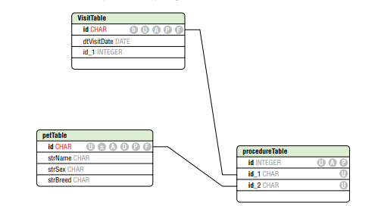
A table is a component of a database that defines a collection of related data. Think about the different data elements as columns in a spreadsheet. These columns describe the components of the table and all the rows are the instances of data in the table.
Using a relationship database, fields within one table can relate to fields within another table. You can see a simple example of this in Figure 14.4. This is called an entity-relationship diagram that shows the relationship between the tables in the database.
14.4
These relationships keep associated data mapped together without having to have a single enormous database table with a lot of repeated data.
For example, in Figure 14.4, you can see that there is a table that defines a pet. This table has a unique identifier field, a name, a sex, and a breed. Then you have a visit table that includes the visit date.
Since each pet will have multiple visits, you need a way to map those two rows together. This can be done in a third table. You include the key identifiers from the rows in the other two tables.
This table keeps that mapping from the other two data structures. This entity-relationship diagram is a way of thinking about the model, and its implementation is the data layer of the multitier architecture.

Slide 19
Service-Oriented Architecture
A service-oriented architecture takes a different view of applications. Rather than thinking about applications from end to end (user to data store), it looks at the different functions needed to make applications function.
The programmers who make use of a service may have no idea how it works internally. All they know is how to consume the service in a useful way.
This means the communications protocols are well defined. They may use communications protocols like Remote Method Invocation (RMI), Remote Procedure Call (RPC), or even Representation State Transfer (REST).
These existing communications protocols mean the programmer doesn’t need to create their own protocols to communicate from one service to another. The services make use of these protocols to communicate to other services through the use of libraries rather than needing to create entirely new communications methods.
Another advantage of service-oriented architectures is that once you abstract functions to services and allow the communication to happen outside of just calling a function within the same process space as the calling function, you can place that service anywhere.
Fast networks and fast processors make this further abstraction possible. It also potentially limits the reach of a compromise. Once a service has been compromised, the only thing an attacker gets is access to that memory space.
There may be nothing in that memory space or even that system other than ephemeral data that isn’t even complete, depending on the implementation of the services and the overall design of the application. It does, though, mean that often services are exposed externally, so an attacker could probe from one service and system to another.

Slide 20
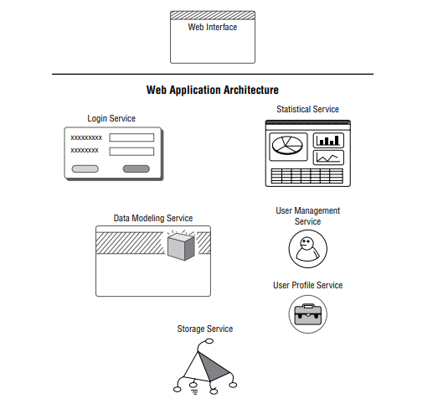
Unlike a virtual machine, which is a full operating system running on top of another operating system, a container uses the same kernel as the host operating system.
This means you are not running a full operating system inside of a container. The only thing that exists in the container is the application and any library dependencies that are necessary for the application or service to function correctly.
This keeps the overhead associated with containers low. The container will also get its own network interface, so it does appear to other systems as though it’s a separate device altogether.
A container can be run inside of a virtual machine. While it’s technically still possible to run a virtual machine inside another virtual machine, there is overhead from the multiple layers of abstraction of interrupts and memory devirtualization.
With modern computers, it may not be noticeable, but it’s still overhead. Containers alongside microservices or service-oriented architectures will change the deployment model for applications.
There is no longer a need to stand up completely different systems, virtual or physical, when all you need to do is create containers for the different services a complete application comprises.

Slide 21
Cloud-Based Applications
In essence, using cloud computing providers is just another way of outsourcing infrastructure. This is not to say that’s all a cloud provider offers. You can deploy a traditional multitier application at a cloud provider, and you would get a transference of the risk that may come from exposing a network-based application to attackers in the outside world.
This exposure could allow an attacker to gain access to that application and then pivot to other systems within the enterprise. Moving to a cloud-based deployment can help alleviate that exposure.
There are better ways to make use of a cloud-based application model, though. For a start, cloud providers like Microsoft, Amazon, and Google allow for the creation of containers to deploy applications to. This means you don’t have to worry about how you might deploy containers within your environment.
Your cloud provider will take care of all of the infrastructure and management for you. While containers are comparatively simple, they do require some management. The cloud provider will take care of that management for you.

Slide 22
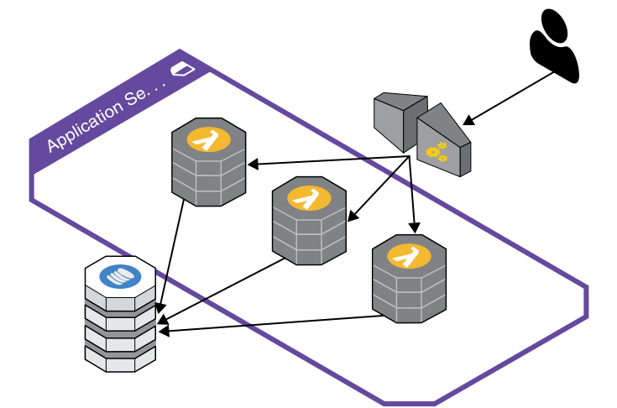
dvantage of when architecting an application. There are log services, log watch services, and services to create a trail of events that can be useful in the case of the application being compromised. The event logs and available audit trails will be important for an investigation to determine point of entry and extent of compromise.
Additionally, providers like AWS will handle all identity and access management, making them considerably more capable than smaller organizations that don’t have as many services at their disposal. Above and beyond what AWS offers natively, which is substantial, many vendors also offer their own services as AWS instances.
The services may include unified threat management appliances, firewalls, intrusion detection systems, and many other types of security devices. Rather than hardware appliances, these are all virtual instances running the same software as a hardware device would. All of this is still focused around more traditional application design, however. Cloud services may also open the door to newer ways to conceive of applications.
If you string a number of serverless functions together, you can create an application. If, by chance, one of the functions has a vulnerability and it could be compromised, there is no server on the backend to take advantage of. Figure 14.7 shows a possible AWS architecture that may include no servers or even containers.
14.7

Slide 23
The architecture shows a user connecting to an API gateway.
This provides the means to access functions that are provided by the Lambda services you can see in the middle.
On the backend, there is a NoSQL database for application storage, including user-based state information. It is a very simplistic design, of course.
There are far more complex ways to design cloud-based architectures. There are also multiple ways to store data associated with the application.
This may include storage on the client side using a virtual connection from the application network to the client network.
However, there are also multiple ways to do fi le-based storage or databases with cloud service providers.

Slide 24
Database Considerations
Databases have been relational for decades. The language used to interact with a relational database is SQL, which was developed in the 1970s. There are a number of common SQL (relational) databases that you may run across.
Oracle has long been a big name in SQL databases. Not only does it have its own enterprise-grade database, it also acquired MySQL several years ago, a popular open-source database server. MariaDB was forked from MySQL in 2010, before the Oracle acquisition. In some cases, MariaDB has taken the place of MySQL in Linux distributions.
Microsoft’s SQL Server is also a very common database server, particularly in organizations that are already heavily invested in Microsoft infrastructure. No matter which SQL server you are using, it is actually a server, meaning it is a service that runs, accepting connections. The connections can be over the local network, meaning there is an open port that listens for requests.
Different servers will use different port numbers. For instance, MySQL uses TCP port 3306, while Microsoft’s SQL Server uses port 1433. MySQL will not operate using UDP, though Microsoft’s SQL Server can be confi gured to use UDP for connections from clients. Listening services are problematic on the network because there is the possibility of an unauthorized client connecting.
Strong authentication credentials are especially essen tial in cases where the connection has to be over the network because the client is on a separate server. It’s possible, though, to use named pipes for clients on the same system as the server. This is a type of interprocess communication where there is no port listening for network connections. One process connects to another process using this named pipe.

Slide 25
SQL injection attacks are accomplished by injecting SQL into a web form, which may require some obfuscation.
If an attacker can gain direct network access to the database server, they won’t need to manipulate the query.
If the attacker can get authenticated access, they can just issue queries and obtain the contents of the database.

Slide 26
Not all databases are managed by separate pieces of software like a database server. In some cases, the database functionality is embedded into the application making use of the data.
Such is the case in the Firefox web browser. All data used by Firefox, including bookmarks and settings, is stored in a SQLite database.
Many other applications, perhaps especially mobile applications, make use of SQLite databases. They are stored as files. The application makes use of library functions to manage the data stored in the data files.
As it’s a SQL-based relational database, all programmatic access is still handled using SQL queries. To retrieve data, the program would generate a SELECT query. Storing data would be handled using an INSERT INTO query

Slide 27
Security Architecture
Organizations should consider the use of a security architecture. This may be a confusing term. When some people hear security architecture, they may think about the network design and all the security elements that would be placed into the network. This, again, is a bit of a defense in depth approach to network design and thinking. Enterprises need to take a much broader approach to architecture.
A security architecture should start at the very top of an organization so goals and business objectives are identified. This ensures that all security functions within the organization are designed and implemented to support business goals. An architecture should identify the analysis, design, planning, and implementation of security functions. There was a time when security was more of a siloed function, standing off to the side. A security organization may have had to stand on its own and create its own requirements.
This was a result of a general lack of understanding of the value and functionality of security and its importance to the organization as a whole. In the absence of business-generated goals, the goals of the security organization were developed from the bottom up, which means the technical needs may have been put in front of anything else.
As data breaches have become far more prevalent over time, businesses have started to recognize the need to take security on as a function of not only executive management but also the board of directors.

Slide 28
To achieve this top-down defined security architecture, the business should take advantage of any business road maps or long-term planning already in place. They should also make use of trends, whether they are industry trends or intelligence related to threats that may be specific to the business or the vertical industry the business belongs to.
The most important factor for businesses to consider is how they handle risk. Risk is the probability of the actualization of loss or damage resulting from the exploit of a vulnerability.
Businesses may have different perspectives on risk, based on how they have identified threats or quantified loss or probability of that loss. Overall, the business needs to manage risks to the business, and businesses have become more aware of risks associated with their information resources.
Once a business has a handle on risk identification and management as well as the planning that would go into risk management, it would be able to generate requirements that should go into a security architecture. A business should have a methodology to follow that provides additional guidance.
This could be handled by adopting a framework to use. The National Institute of Standards and Technology (NIST) has a Cybersecurity Framework that has been identified to highlight phases in which a business should consider implementing security controls. The phases or categories identified by NIST are Identify, Protect, Detect, Respond, and Recover.
NIST refers to these as the Five Functions, and they are the core of the NIST Cybersecurity Framework. You can see the Five Functions depicted in Figure 14.9. You’ll note that they are in a circle. This is because each function has inputs into the next. The cycle also never ends.

Slide 29
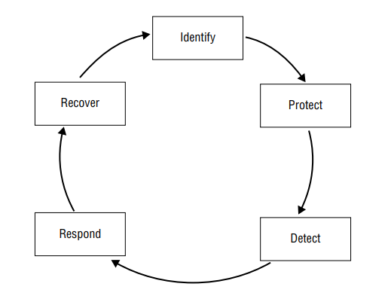
A security control is a means of avoiding, detecting, counteracting, or minimizing security risk.
Security risks may include firewalls or intrusion detection systems, for example.
They may also include door locks or bollards for physical security.
There are a lot of categories that security controls may fall into.
14.9

Slide 30
NIST is not the only player in the space of providing guidance that can be useful in creating a security architecture. There are several others as well. One is the International Organization for Standardization (ISO).
It publishes guidance for information security management systems that is called ISO 27001 (sometimes referred to as ISO/IEC 27001).
It provides another way to think about implementing information security systems. ISO 27001 has a simpler cycle than NIST provides with its Cybersecurity Framework. The cycle for ISO 27001 calls for the following: Plan, Do, Check, and Act.
These are all pretty selfexplanatory, except perhaps Act, which is about addressing anything that may come out of the Check phase, which could include implementing preventive or corrective actions resulting from an audit.
One last way to think about implementing information security controls is through the attack life cycle. The attack life cycle is thought to be the set of steps an attacker would take to compromise your organization. You can see the attack life cycle in Figure 14.10.
The attack life cycle is a concept developed by Mandiant Consulting to not only help guide its incident response capabilities but also to inform companies about steps the adversary will take so the organization may be able to better detect what is happening and, as a result, identify the severity of the detected incident. An event indicating initial recon would be far less severe than an event indicating data exfiltration (mission complete).

Slide 31
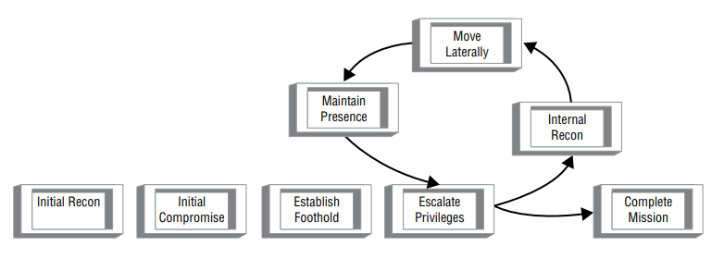
14.10
Businesses looking to implement a security architecture may consider implementing controls to address each of the phases in the attack life cycle. They will want to protect against but also detect initial recon as well as initial compromise.
Some companies may stop here, assuming they will prevent or catch everything. Since the most important actions come later in the attack life cycle, it’s important to be able to manage anything happening there as well.

Slide 32
Summary
Data classification is an essential activity. It helps to identify all data resources as well as prioritize their sensitivity or importance. This action is needed in order to implement a security model.
You would be unable to implement Biba, for instance, if you didn’t know sensitivity or priority, since Biba needs to know who can read up and who can write down. The Biba security model is about data integrity. The same is true for the Clark-Wilson integrity model.
Other models, like the Bell-LaPadula model, aren’t as concerned with integrity as they are with confidentiality. Integrity ensures that data isn’t altered or corrupted by unauthorized users. Confidentiality ensures that data isn’t seen by those who are not authorized. Security models are necessary for implementing mandatory access controls. Applications are designed. As a result, they generally follow known architecture or design patterns.
Native applications that are stand-alone have no external architecture but may have an internal architecture. This means, since they are stand-alone, they don’t rely on other systems or services. A common application architecture, though, is the n-tier, or multitier, architecture.
The multitier architecture is composed of the Presentation, Application, Business Logic, and Data Access layers. Sometimes the Application and Business Logic layers are consolidated to just handle logic for the application, based on business requirements. This would be a three-tier application. This is an implementation of a MVC application design.

Slide 33
Web applications will generally use a multitier architecture. The browser is the presentation layer (view). There is likely an application server, whether it’s running Java .
NET, PHP, or some other language, that handles business and application logic (controller). Finally, there is probably a data store, perhaps in the form of a database, that is the dataaccess layer (model).
Modern applications are still using multitier architectures, but they are also often broken up into functions or services. When an application is viewed or designed this way, it is said to have a service-oriented architecture (SOA).
This means the overall application is broken up into services and the services interact with one another.
It provides modularity so any service can be replaced with another service with the same input/output specifications without altering the rest of the application. Recently, this approach has been adapted into a microservice architecture. Microservices are further enabled through the use of containers like Docker or Kubernetes. Sometimes, these containers are implemented through the use of a cloud provider.
Traditional application architectures can also be implemented using a cloud provider, and you could end up with a hybrid approach where pieces of your application are on your premises while others are implemented using a cloud provider.
Cloud providers are also beginning to expose application developers to new ways of considering their application design.
This includes such things as serverless functions. The functions are connected in order to create the overall application, but there is no server underneath that an attacker could gain access to. Similarly, the use of containers has sometimes led to automated infrastructure, so containers and virtual machines are built up and torn down on demand.

Slide 34
An attacker who gained access to such an environment might have to keep starting over when the system they had access to suddenly went away, including any files that had been put in place by the attacker.
Often, applications need to store data. It may be temporary data or it may be persistent data. Traditionally, application data has been stored in a relational database accessed using SQL.
Modern applications are moving away from this approach and starting to use NoSQL databases, which may use semi-structured documents or key-value associative arrays.
Businesses in general need to think about a security architecture. This is not related to application or even network design or architecture. Instead, it is a set of data and methodologies that guide the overall implementation of security within the organization.
NIST recommends the Five Functions of Identify, Protect, Detect, Respond, and Recover as a way of guiding the organization—organizationally for staffing, but also in terms of how they evaluate information security and any potential risks to the business.
NIST is not the only organization that has security recommendations. ISO 27001 is another set of recommendations for information security management systems. They recommend Plan, Do, Check, and Act.
There is also the attack life cycle that identifies phases an adversary works through to gain access to critical business systems or data. These are initial recon, initial compromise, establish foothold, escalate privileges, internal recon, move laterally, maintain persistence, and complete mission.

